Slide 1
Agenda
Folder structure:
  Most important folders/files.
Dart Syntax
  Simple Dart Program (Entry point).
  Flutter app is just a special dart app.
  Good resources for learning Dart.
Notes:
Hello and welcome to the second video in this Flutter tutorial.
Today we are going to talk about a typical Flutter project structure.
In the last video we got started with Flutter by installing Flutter SDK
and we created our first flutter project and executed it as a web project if you remember.
Today we will be focusing more on how a typical flutter project is structured
Also, we will get introduced to Dart, the underlying programming language for flutter.

Slide 2
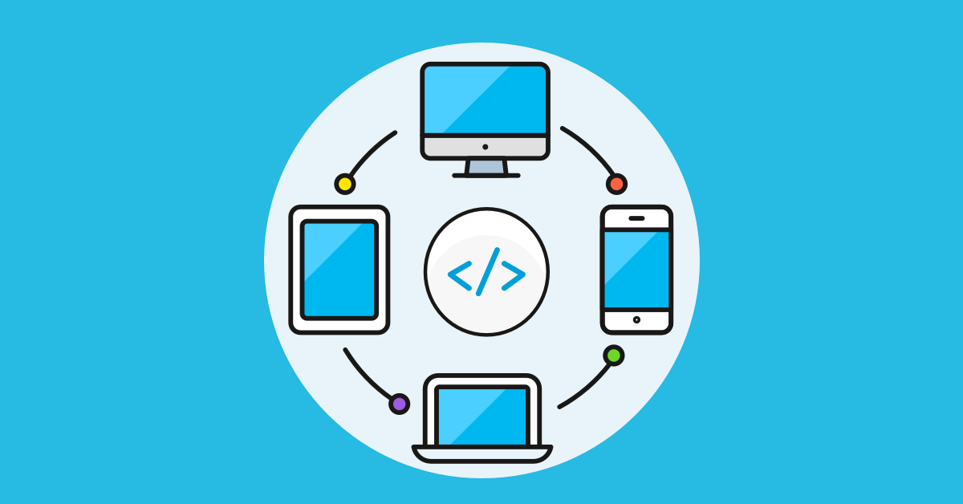
Dart
Flutter
Android
Java
Web
JS
Desktop
C++/C
iOS
Swift
Notes:
If you remember this slide, from the last video
We said that when you write code in Dart,
Flutter translates it to the corresponding language
Based on the target platform.

Slide 3
Dart
./lib
Test
./test
Android
Java
./android
Web
JS
./web
Desktop
C++/C
./windows
./linux
./macos
iOS
Swift
./ios
Flutter
./pubspec.yaml
Output (deliverables)
./build
Notes:
In this slide we see the mapping
between those platforms and their corresponding folders in the project.

Slide 4
Folder/File | Description
./lib | Where your main Dart code lives
./test | To test your code
./pubspec.yaml | Dependency management and flutter version, assets specification.
./pubspec.lock | Locks the versions of dependencies to ensure everyone working on the project uses the exact same version.
./android | Translated android code (Java)
./ios | Translated iOS code (Swift)
./linux | Translated linux code (C++/C)
./macos | Translated macOS code (C++/C)
./windows | Translated windows code (C++/C)
./web | Translated web code (HTML/JS)
./build | Output for each platform, e.g. (.apk) for Android.
./README.md | Just a README file to describe your project
./gitignore | Auto generated by flutter to help ignore the right files when you create Git repository.
./.metdata | Auto generated by flutter framework to track performance.
./.idea | IntelliJ IDE project settings file (Not specific to Flutter)
.dart_tool | Used by “pub” and other tools, pub is a flutter packaging manager.
Analysis_options.yaml | used to configure the Dart analyzer. The analyzer is a tool that checks your code for potential issues and errors, such as unused code, unnecessary imports, and type errors
<app_name>.iml | Related to IntelliJ (Not specific to Flutter)

Slide 5
Dart Syntax | Entry Point
void main () {
// Code goes here …
}

Slide 6
Dart Syntax | Resources
https://dart.dev/language
https://dart.dev/codelabs/dart-cheatsheet

Slide 7
Dart Syntax | Flutter
Flutter application is just a dart application !

